Slide 1
Building Your Child’s Resilience
Presented by:
The Federation of Catholic School Parent Communities

Slide 2

Resilience and social and emotional learning………
…are valuable protective factors
Resilience is our ability to cope with problems and change
and bounce back after these challenges

Slide 3
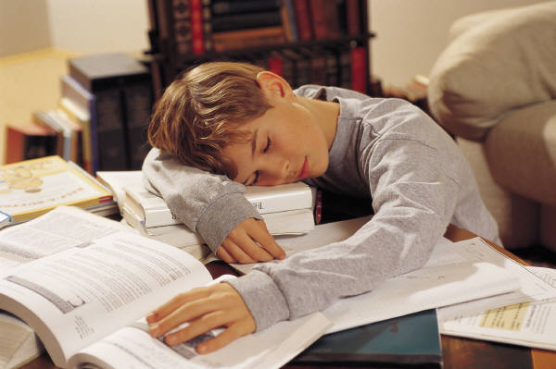
What are some things that are stressful for children?

Slide 4
Bullying and harassment
Research reveals that 1 student in 4 is bullied weekly in Australian schools
Bullying is characterized by repeated incidents, usually by a bigger, stronger, more powerful child on a small or weaker child or a group of children on a single child
It may be: verbal, physical, social, psychological, ‘cyber bullying’
Bullying is about ‘power’ - ‘interpersonal power’ or ‘relationships’ power
You as a parent are very important
in helping your child

Slide 5
Research: Positive Schools Conference 2011
Professor Donna Cross, Edith Cowan University
In 87% of bullying interactions, bystanders are present
Bystanders can be part of the problem OR the solution
Important to include the role of ‘bystanders’ in the school policy
“Everybody is responsible for bullying”
Victims are less likely to receive assistance in a crowd

Slide 6
Research: Professor Donna Cross
When peers intervene:
Bullying will stop in 10 seconds (Hawkins et al)
Parents:
“Social architecture is the best response”
Ensure that children have more than one group of friends

Slide 7
Bullying and harassment
Signs of bullying?
Responding to bullying.
How parents and carers can help.
Listen
Ask what is happening?
Encourage social skills, being assertive, telling the bully to stop, ask for help
Help your child think through different ways to deal with the problem
Work in partnership with the teacher
Keep talking with the school

Slide 8
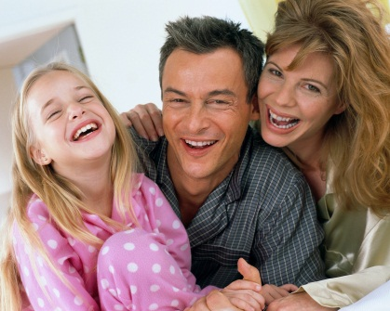
How are your child’s resilience skills developing?
Children’s resilience is enhanced when they:
are loved unconditionally
have an older person outside the home they can talk to
are praised for doing things on their own
can count on their family
know someone they want to be like
believe things will turn out right
have a sense of power greater than themselves

Slide 9
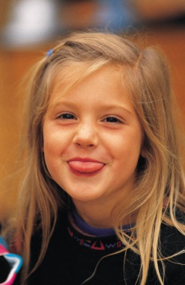
Children’s resilience is enhanced by:
are willing to try new things
feel that what they do makes a difference in how things turn out
like themselves
can focus on a task and stay with it
have a sense of humour
make goals and plans, both short and long term

Slide 10

What do we all want for our children?
SEL develops
young people’s capabilities:
• Emotional resilience
• Positive mindset for achievement
• Getting along
• Social responsibility

Slide 11
Social and emotional learning ........
…..is about learning how to
Manage feelings
Manage friendships
Solve problems
Kids Matter Primary: www.kidsmatter.edu.au

Slide 12
Children who have developed social and emotional skills ....
Manage
themselves
Relate to others
Resolve conflicts
Feel positive about themselves and the world around them
...find it easier to:
Parents and carers
have a critical role to
play……
in guiding and
supporting children’s
social and emotional learning.
Work in partnership to support
the school’s resiliency program
via homework activities etc;

Slide 13
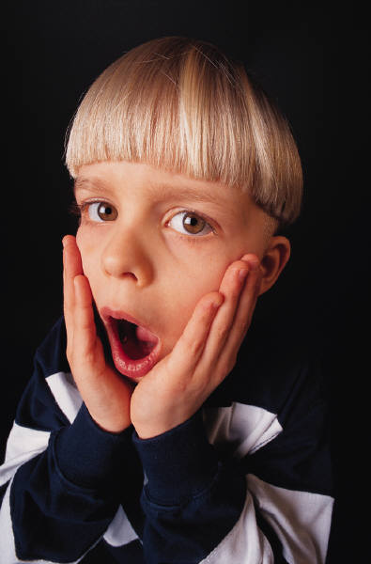
Manage feelings:
Children need support from parents and carers to manage their feelings effectively
Encourage discussion of feelings
Truly listen.
Put feelings into words: happy, sad, angry etc,
Act the way you want your children to act.
Use positive ‘self-talk’.
(Mark Le Messurier: ‘Parenting Tough Kids’ Simple proven strategies to help children succeed)
Lead by example: role model how you deal with feelings. “I’m feeling really tense, I need to take some deep breaths to calm down”

Slide 14

Resilient people have:
Self esteem: positive sense of self
Skills: to cope with stress and challenges
Support: good role models- at least one caring adult

Slide 15
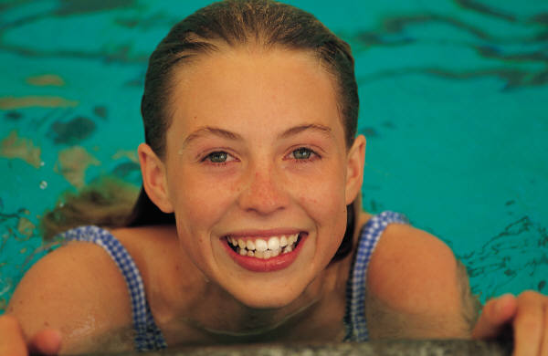
Resilience
Assisting children to know their strengths.
Point out to kids what they are good at.
According to Martin Seligman (Optimistic Child):
‘those people who know their strengths are those who are most resilient’.
(Authentic Happiness website)

Slide 16
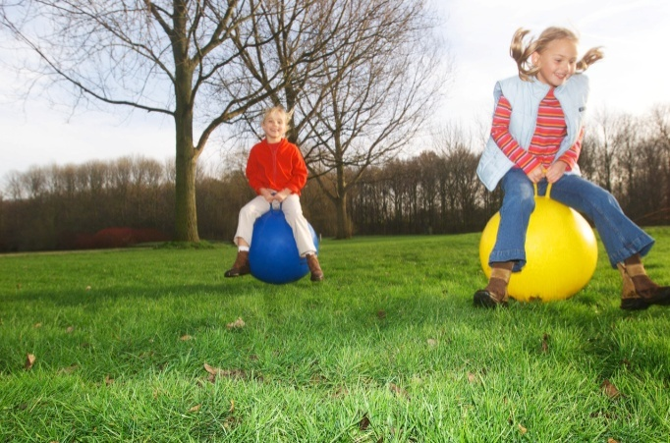
Aspects of resilience
Genetic
Skill set
Optimism
Independence
(Michael Grose: ‘Bringing out your child’s resilience’)

Slide 17
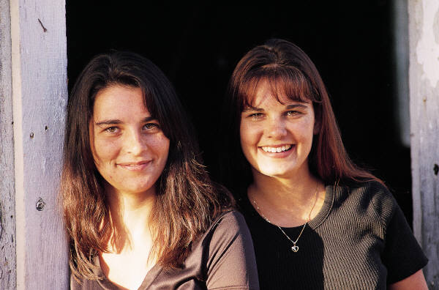
What personal attributes do resilient people have?
Qualities and values
Friendship skills
Self-esteem and learning
(Michael Grose: ‘Bring out your child’s Resilience’)

Slide 18
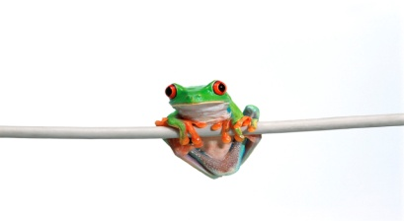
Personal attributes of resilient people.
Persistence
How persistent is your child?
Encourage ‘persistence’:
Develop a vocabulary ‘Work hard and hang in there’.
You might say: “Keep practicing a few more times. Just think how proud you will feel when you play really well at your performance in a couple of weeks”.

Slide 19
Attributes of resilient people:
Encourage:
Personal responsibility: for their behaviour. Chores at home and a roster to follow.
Respect: Kindness. Manners are a sensitive awareness of the feelings of others.

Slide 20
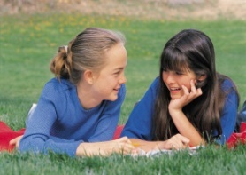
Friendship skills:
Making friends
Children who are able to form friendships at school are happier and learn better.
Strategies for parents:
Teach friendly behaviours
Talk about conversation starters
Invite one friend over at a time so they may form one friendship at a time.
Play games so they learn to be gracious winners and good losers.
Show children how to resolve conflict by compromising.
(Michael Grose, Bring out your child’s resilience)

Slide 21
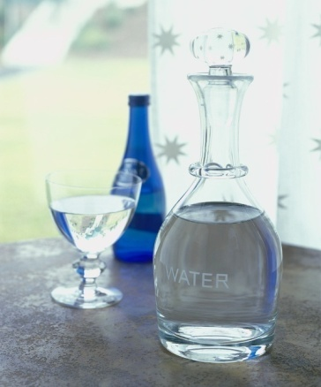
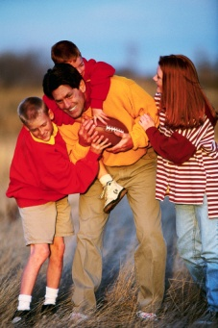
Friendship skills:
Handling rejection
‘When life doesn’t go their way!
Model optimism.
Talk to them about how you handle disappointments.
Talk through a problem, recognise and accept their feelings.
Laugh together: things will get better. They always do.
(Michael Grose, ‘Bring out your child’s resilience’)

Slide 22
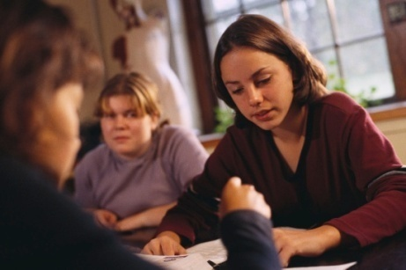
Friendship skills: Managing emotions
Five steps to manage anger:
Recognise it.
Name it.
Choose it: stay in control or lose it.
Say it: “I feel really mad when you say nasty things to me”. “I feel like…..
Teach kids how to calm down. (Michael Grose ‘Bringing out your child’s resilience)

Slide 23
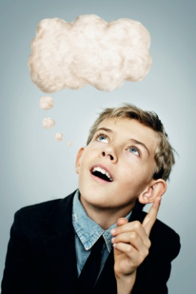
How thinking effects feelings….
Understanding that what we think affects how we feel and how we behave helps children and adults learn effective ways of managing emotions.
Challenge unhelpful thinking
“I can see how you might think that, but maybe there’s another way of looking at it”.. (www.kidsmatter.edu.au)

Slide 24

Friendship skills:
Smart decision making
Three areas:
Parents rule.
Work things out together.
Kids decide.
Three questions children may use to assess
consequences of decisions:
‘Is this behaviour safe for me’.
‘Is this behaviour fair to others’.
‘Is this behaviour smart and in my long term interests’.
(Michael Grose: ‘Bring out your child’s resilience’)

Slide 25
Self esteem and learning:
Optimism:
Model positive thinking and positive self-talk.
Challenge negative talk.
Teach positive tracking.
Teach children to positively reframe.
Language of resilience.

Slide 26

Self esteem and learning
Health and fitness: TV free day. Healthy eating
pyramid.
Join in physical activity.
Motivation to achieve and improve: Personal
bests.
Game based learning.
Organisation: chunking, goal setting, making
plans, managing time lists, family calendar.

Slide 27
Confidence and Self-esteem
Boost confidence and self-esteem.
‘As parents we are mirrors for our children’
“Hey you are a fairly capable individual and you
are capable of lots of things”.
(Michael Grose: ‘Bringing out your children’s self-confidence)
Is it OK to praise kids?
‘Praise’ is important and has a role.
Praise in small doses. Praise is about gaining approval.

Slide 28
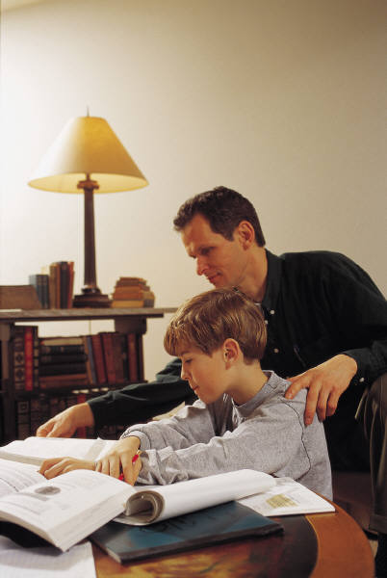
Confidence and self esteem
Encouragement is more powerful, more effective and far more lasting in developing confidence in children.
e.g. “You do a good job of…”
“You have improved in….”
Encouragement is the key to promoting a sense of self-esteem and a strong sense of self.
Every child needs someone in their life who says to them:
‘You can do this’.

Slide 29
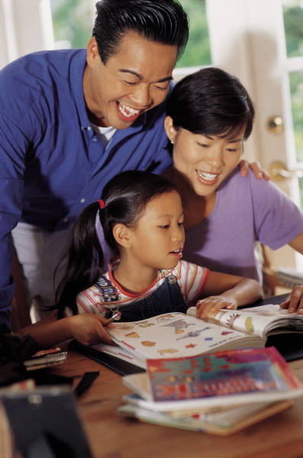
Building self esteem
How parents can help….
Keep family rituals.
Show your child you have faith in them.
Don’t solve all their problems.
Teach children personal safety.
Teach them to trust their feelings, and recognise that they don’t have to keep secrets which frighten or hurt them.
(Parent Easy Guides, Parenting SA)

Slide 30
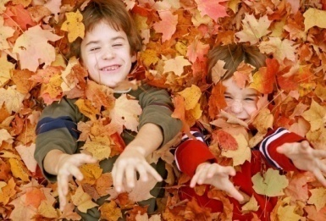
Environmental attributes
Strong families: positive resilient role models.
Contribution; Discipline; Communication; Rituals and traditions
School and community:
Child-friendly neighbourhood.
Positive peers
Activities:
Free play
Out of school activities.
(Michael Grose: ‘Bring out your child’s resilience’)

Slide 31
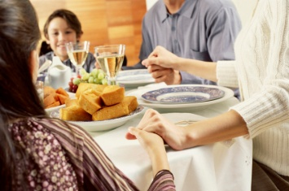
How can parents promote resilience?
How resilient are you?
Aspects of the environment that promote resilience
Firstly: be an emotional supporter, ‘come on, hang in there, life will get better, it generally does’.
Secondly: role model optimism.
Thirdly: give children the opportunity to help or contribute to the family. (Michael Grose: ‘Bring out your child’s resilience’)

Slide 32
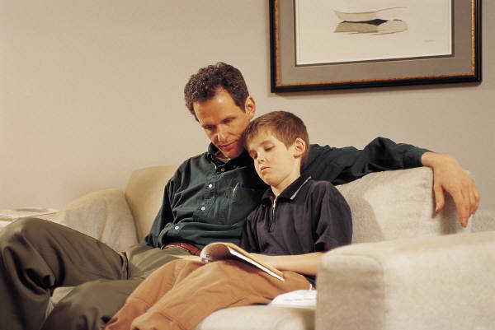
Promoting resilience: strategies for parents
‘We can sometimes forget that kids only see one
side of any story’
Use ‘teachable moments’
Help kids to see both sides…
“How could you find out what Jo is feeling sad about? and “What do you think you could do to help?”
‘If we are always there to protect them and rescue them they wont draw on their own resources’
(Michael Grose)

Slide 33
Promoting resilience
When raising children it is also important that we teach children to differentiate between a want and a need.
It’s OK to say NO and that children don’t always get what they want when they want it.
Help children to process what they hear and make sense of what they are listening to e.g. bushfires / floods etc / terrorism.
Give them a realistic view of the world.

Slide 34
Seven resilience promoting practices for parents
Firstly, practice resiliency yourself.
Secondly, be supportive not protective.
Thirdly, use those teachable moments.
Fourthly, become involved in their lives but you don’t have to be involved in the minor issues of their lives. Be engaged and involved in your child’s learning and school.

Slide 35
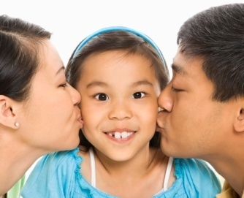
Resilience promoting factors for parents
Fifthly, set limits on indulgences and boundaries on their behaviour.
Sixthly, delay immediate gratification for long term goals. Don’t always give kids what they want and
Number seven, help your child process the world.
Finally: ‘You are your child’s first teacher’
‘You make the difference’ What you think, what you say and what you do is very important.

Slide 36

Who can help?
Kids matter: www.kidsmatter.edu.au
Kid’s Helpline: kidshelp.com.au
Reach Out: au.reachout.com
http://www.youtube.com/watch?v=M0yhHKWUa0g

